Slide 1
Marketing for startups
Lisa Enckell

Slide 2
Lisa Enckell
INTRODUCTION
Partner, Antler
Former VP marketing at Wrapp, a rewards and loyalty app. Interim CMO/marketer and advisor for multiple early-stage startups including Operator, Clue, Qapital and King.
Background in growth marketing and product management for early-stage start-ups.
Active angel investor, part of Antler’s investment committee and working on the Antler global platform.

Slide 3


Marketing for startups
Marketing for startups
– what does that mean?
Positioning
How to get your first users
Q&A

Slide 4
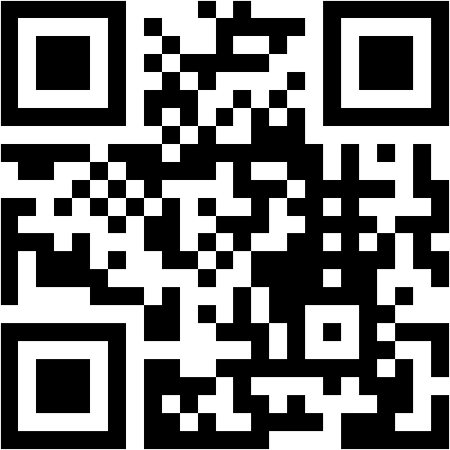
Marketing at a startup, what does that mean?
Go to menti.com use
34 76 58 4

Slide 5

The different parts of marketing at a startup
Growth marketing
SEO and app store optimization
Funnel optimization
Referral and viral features
Retention and notifications
Performance marketing (paid ads)
Analytics and tracking
Content marketing
Brand marketing
Build the brand and its elements
Craft the story
Branding and visuals
Key messages
Create brand awareness
Create collateral for campaigns
Build one coherent brand
Product marketing
User research
Customer testimonials
Competitive analysis
Pricing
Product positioning
Product launches
Copywriting in products
Notes:
Product marketing
User research
Customer testimonials
Competitive analysis
Pricing
Product positioning
Product launches
Copywriting in products

Slide 6
PR and communications at startups
Media relations
Create the company narrative
Build relationships with media
Write and pitch news stories
Media training
Crisis management
Product reviews
Monitor media and mentions
Events and conferences
Speaking engagements
Host own events
Networking opportunities
Sponsorships
Booths and events around conferences
Prepare keynote presentations
Social media
Build presence on social media
Monitor social media
Respond on social media
Content creation
Influencer partnerships
Encourage user generated content

Slide 7
Positioning

Slide 8
Positioning
Explain your product in an way that lets anyone repeat it to their friends.

Slide 9
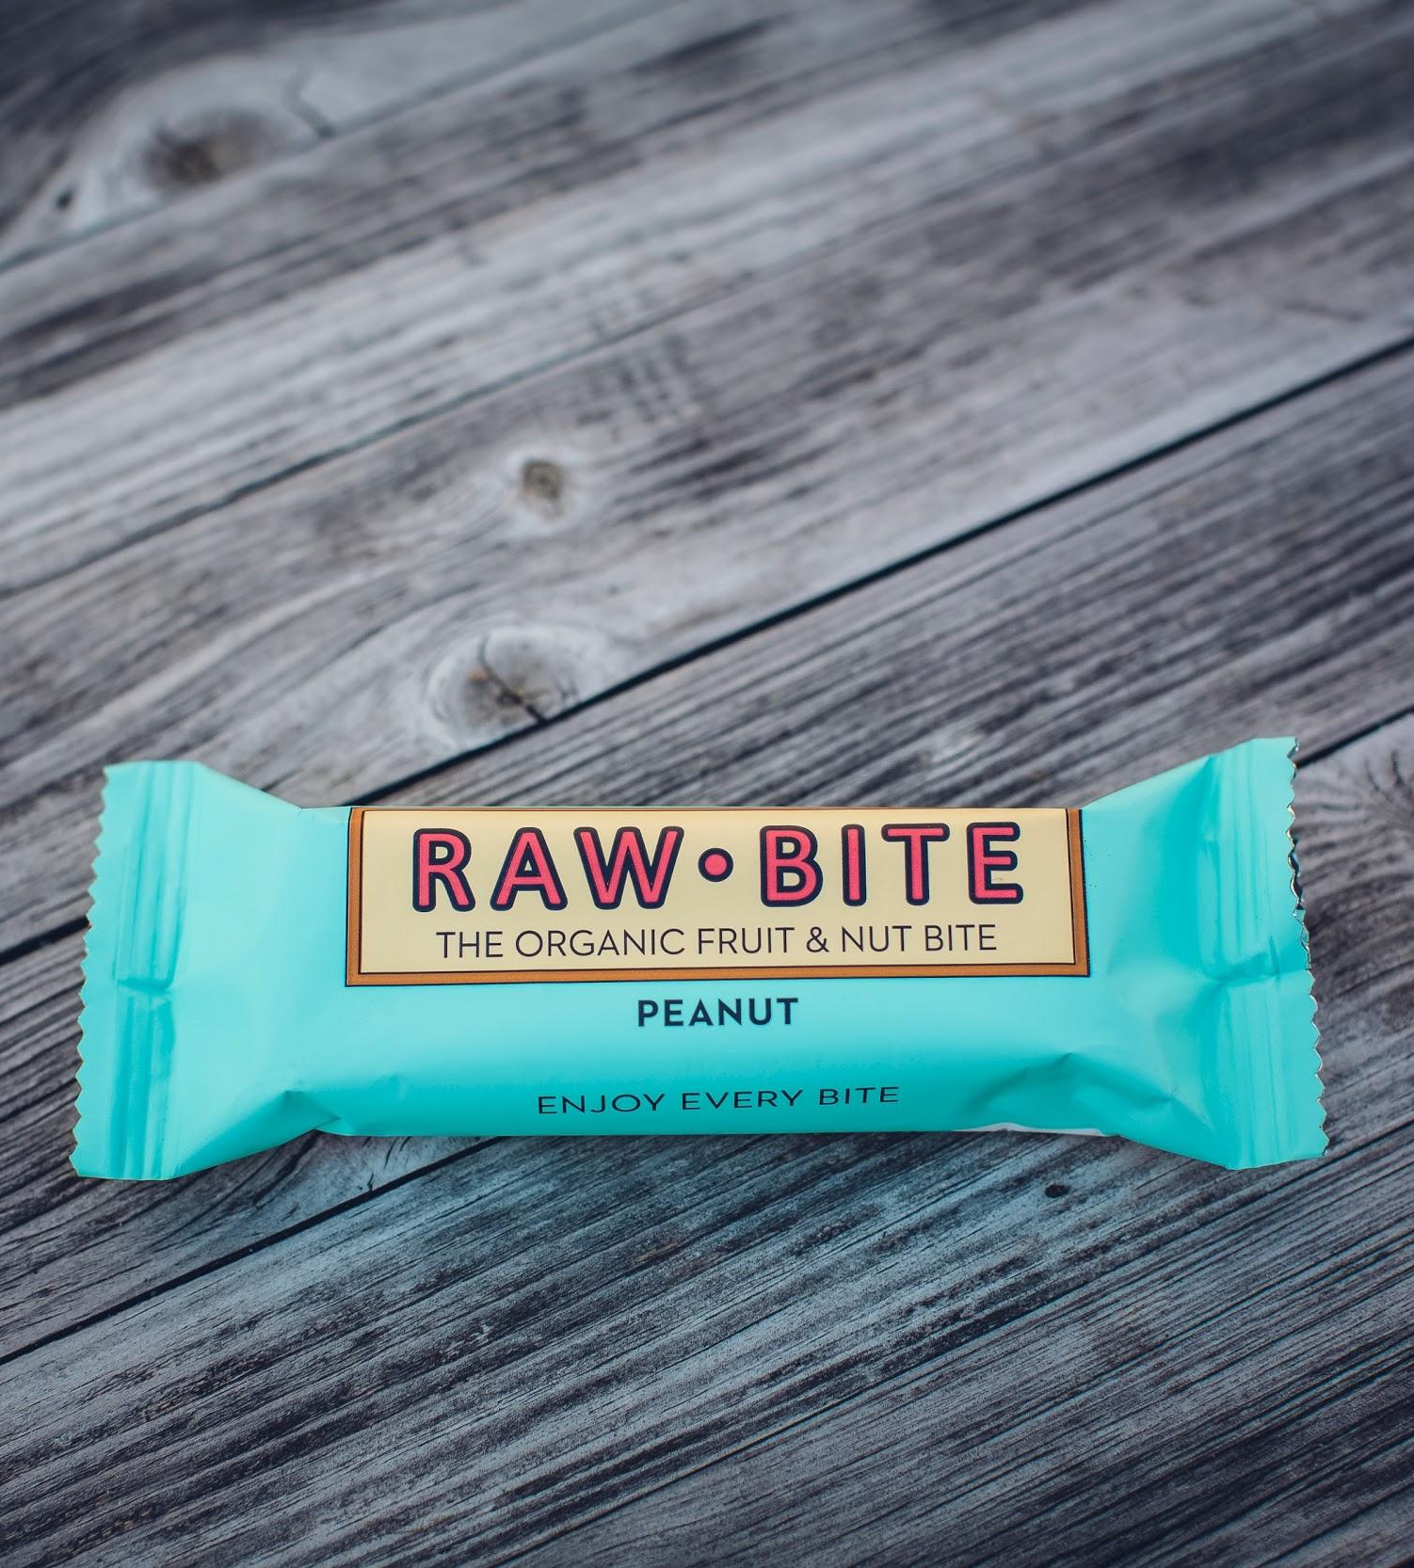
Pick the right category
Picking your category is hard, but necessary. The category:
Determines when our product gets considered
Defines the competition
Shapes expectations
Guides evaluation

Slide 10

Target audience
Pick one person
How can you reach her?
How is your product making her life better?

Slide 11
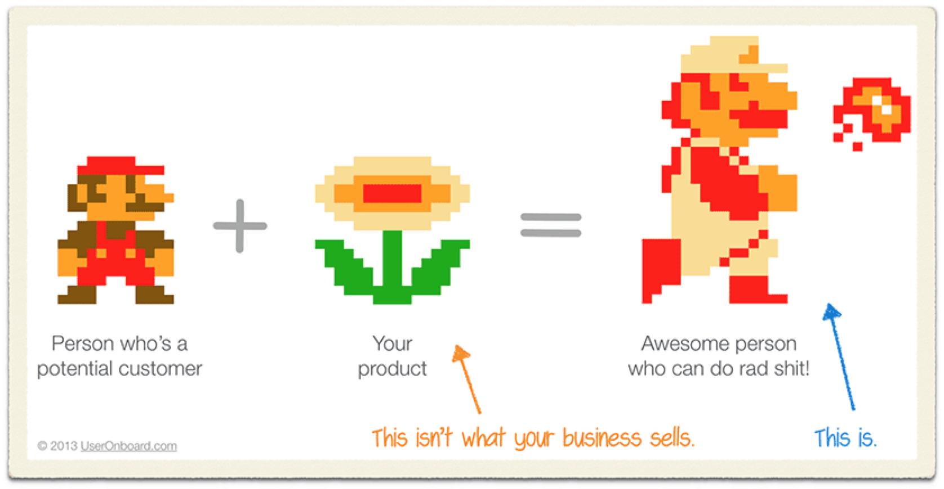
Value proposition

Slide 12
Points of parity and points of difference
Points of parity
How are you as good as others in your category? As the old-school alternatives?
Points of difference
What makes you different from others in the category?

Slide 13
Getting your first users

Slide 14
Where to start?
Build a product first, then get the users?
Build and audience first, then product?
Go to menti.com use
34 76 58 4

Slide 15
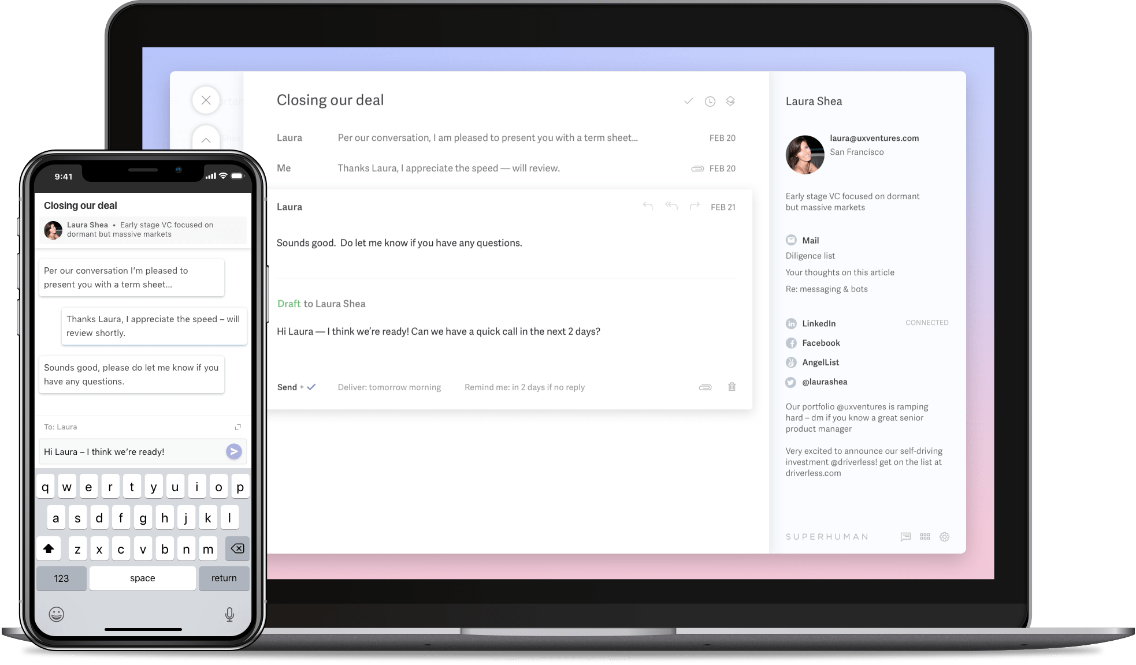
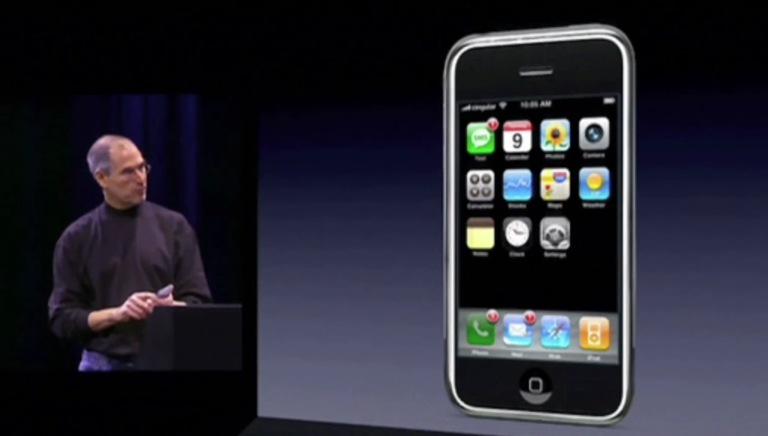
Different go-to-market strategies
Superhuman
Apple
Built hype and a long waitlist
Kept things secret until product is ready

Slide 16
How to get your first users?
Optimize your funnel
Make your brand visible
Launch your product
Pitch the media
Host events
Share on social media

Slide 17

Is your traffic converting?
Optimize your funnel
Are people signing up?
Where are you “leaking”?
Why are you “leaking”?
Fix the most critical leaks before turning on the tap!

Slide 18
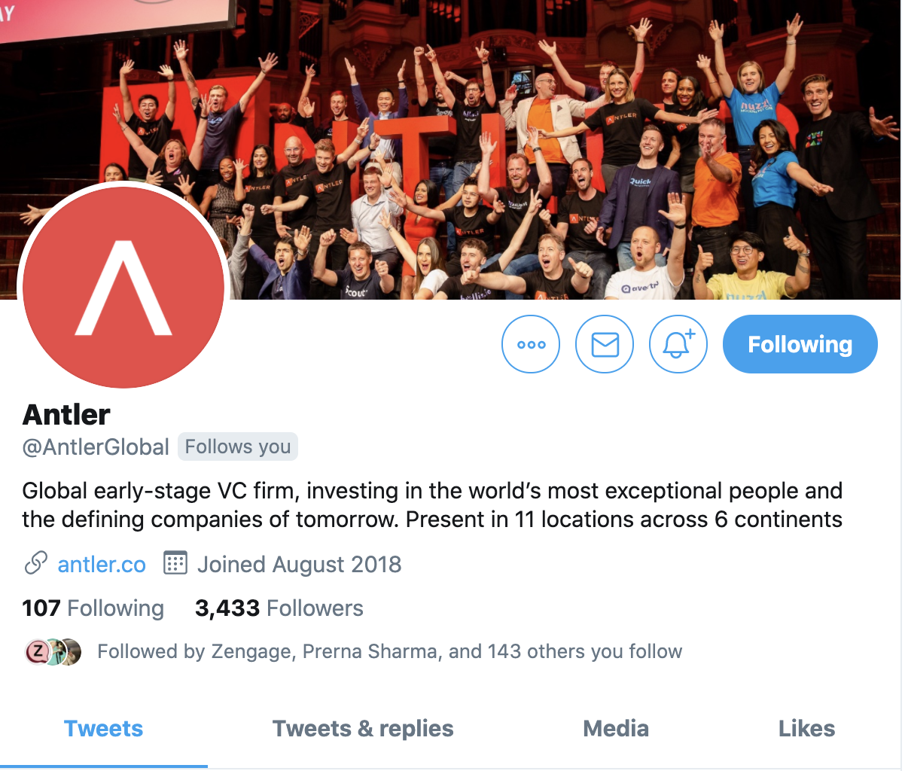
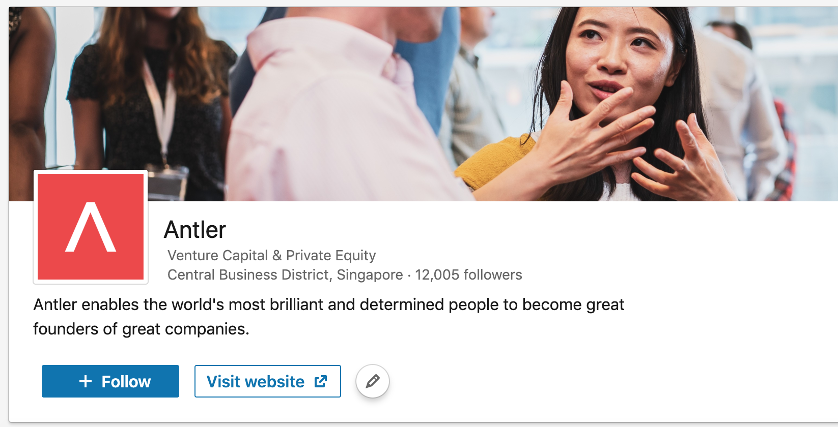
Claim all the channels – even if you don’t use them today
Make your brand visible

Slide 19
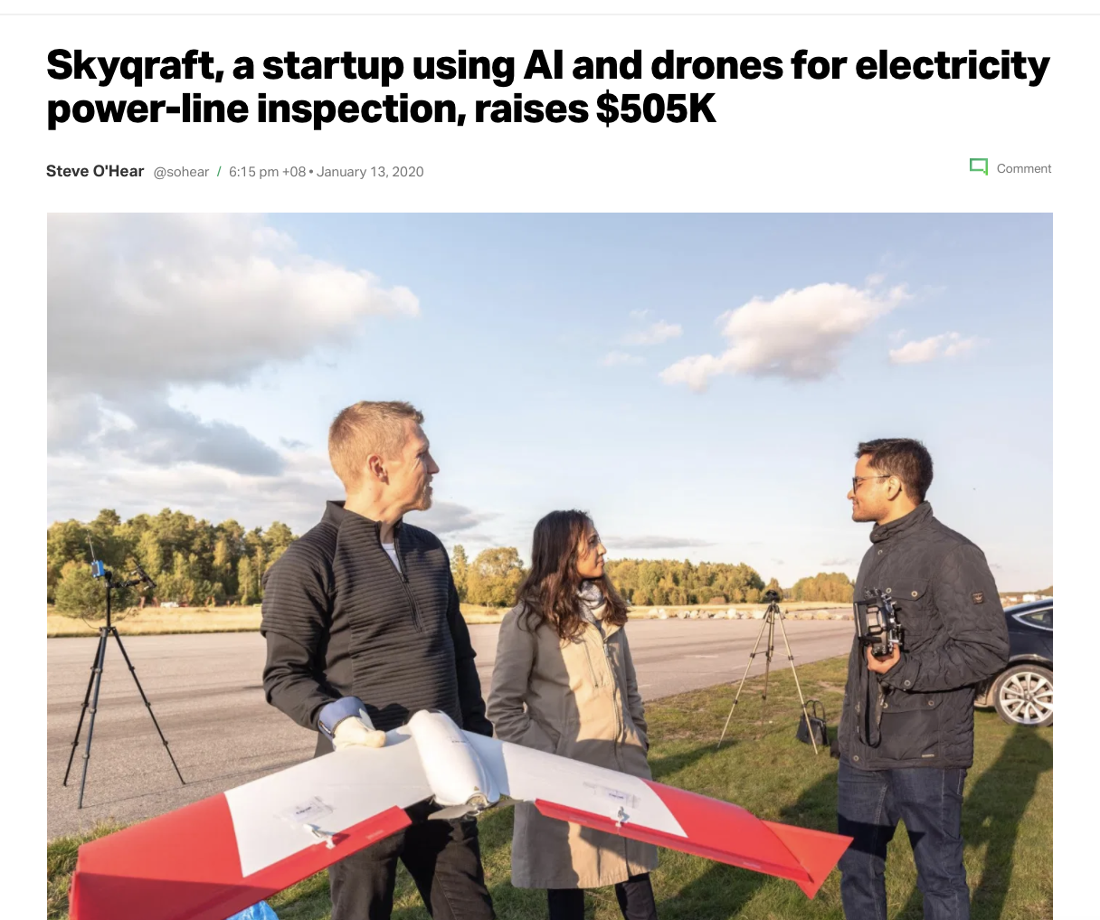
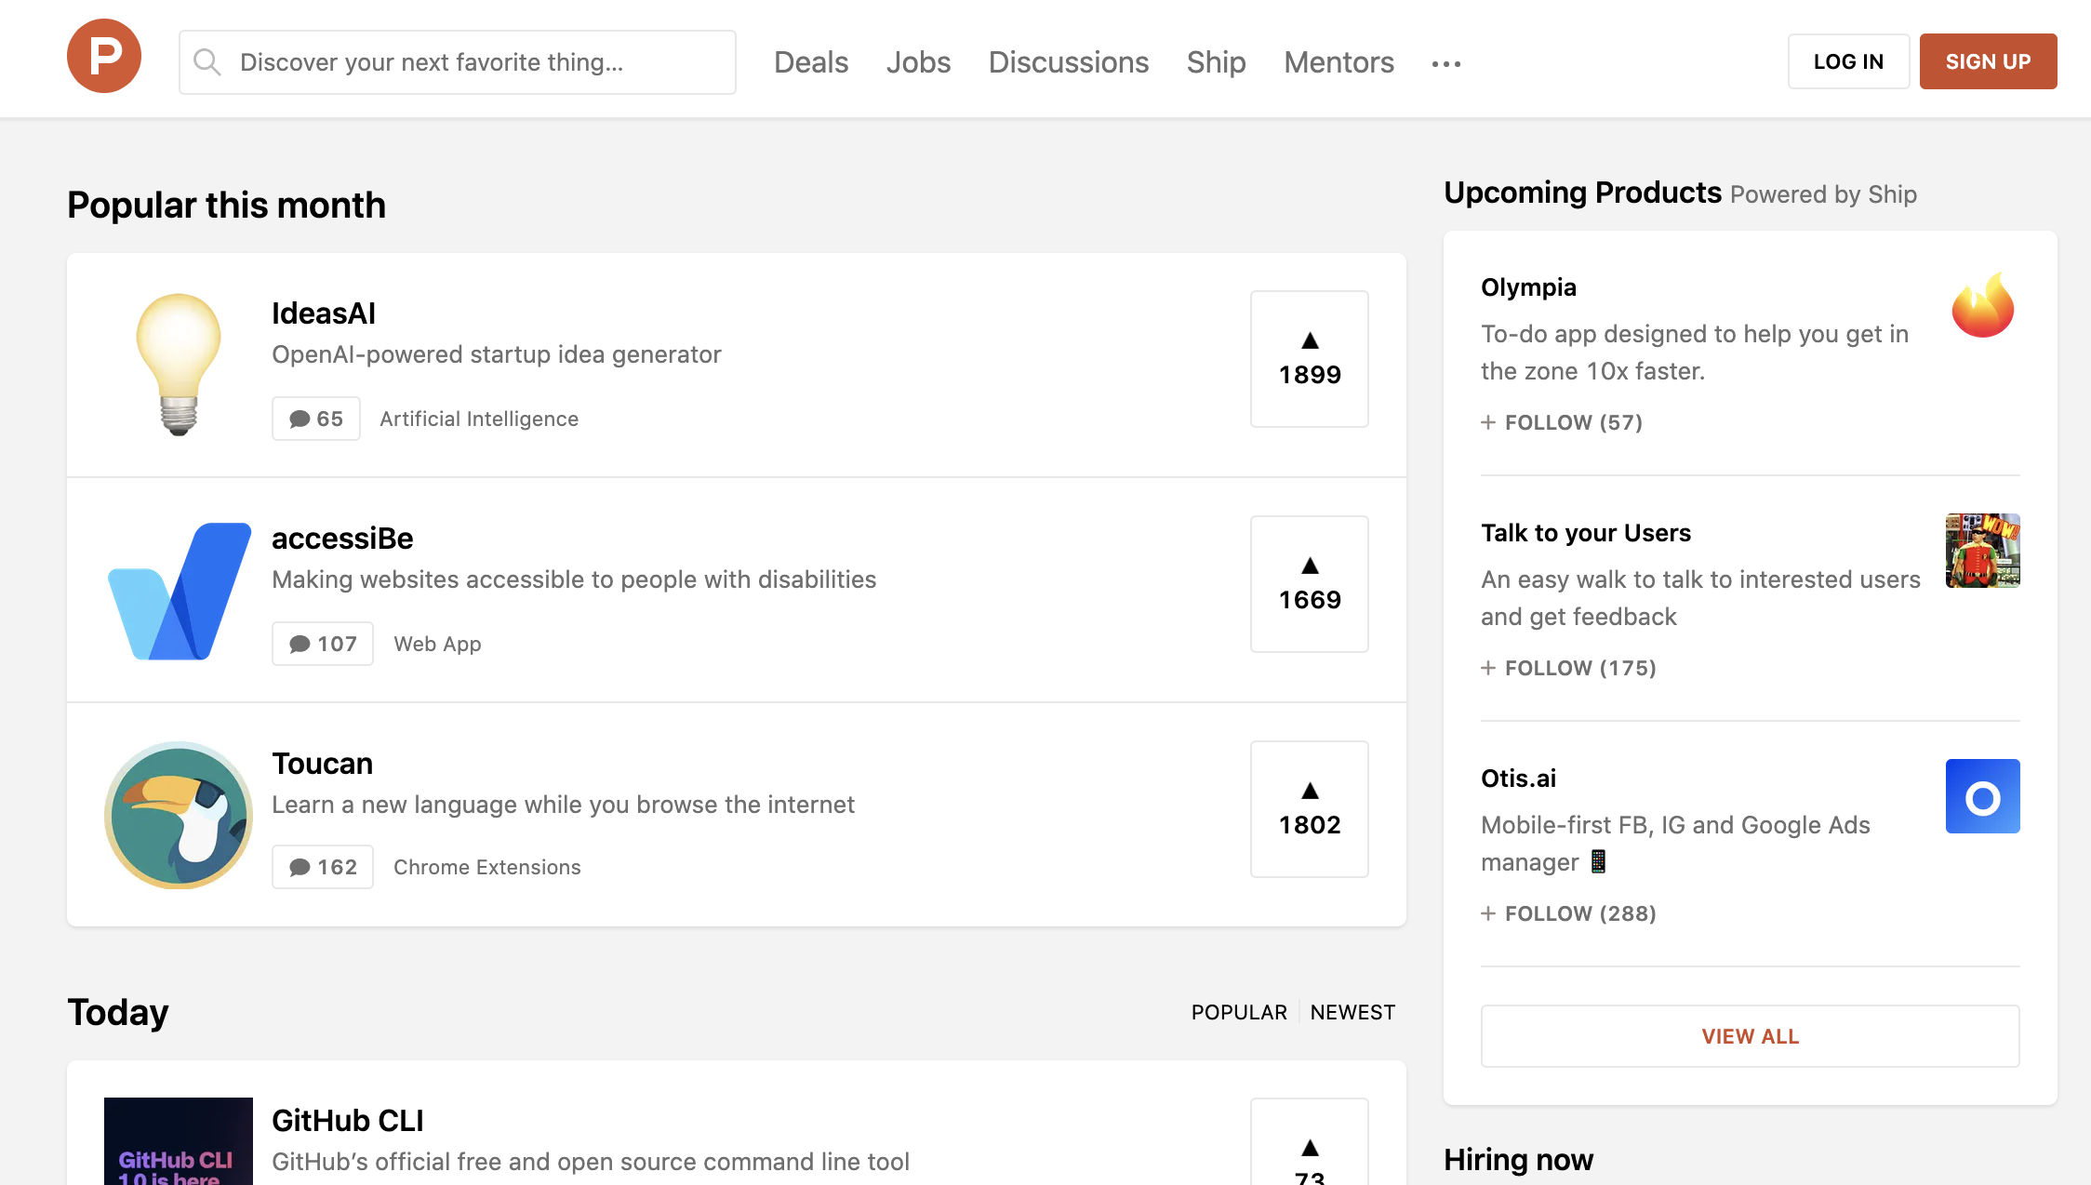
Launch on multiple channels at the same time
Launch your product
Pitch the media

Slide 20

Launch party – share on social media
Host events

Slide 21


Use your personal own brand on social media
Share on social media
Lisa
My new startup

Slide 22
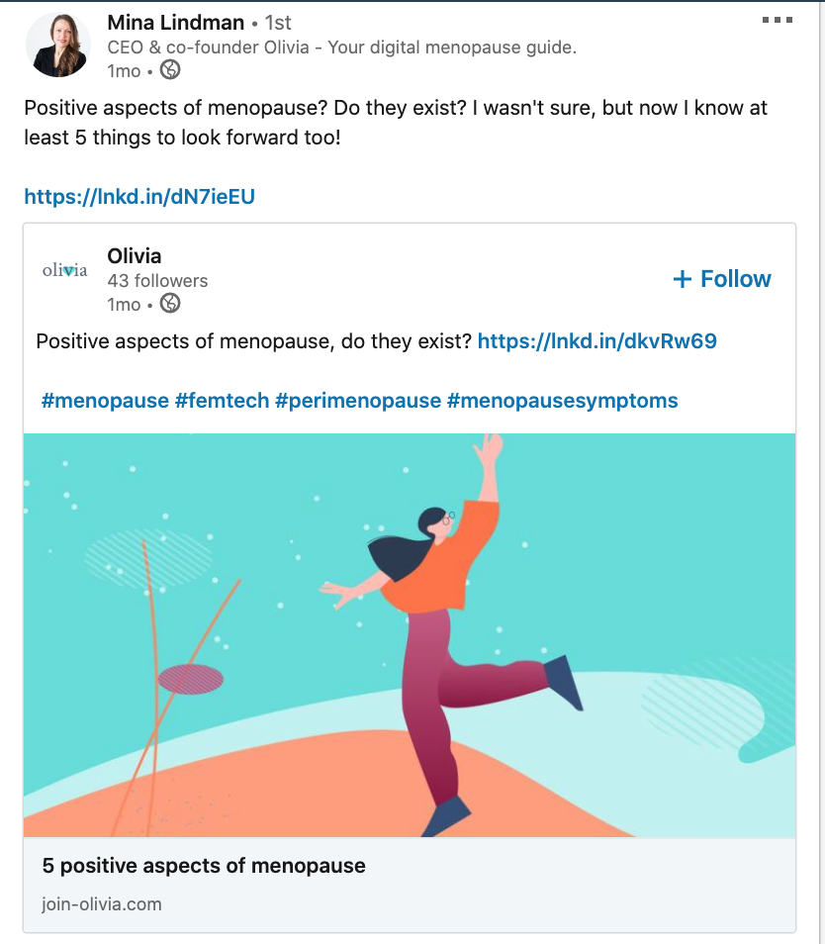
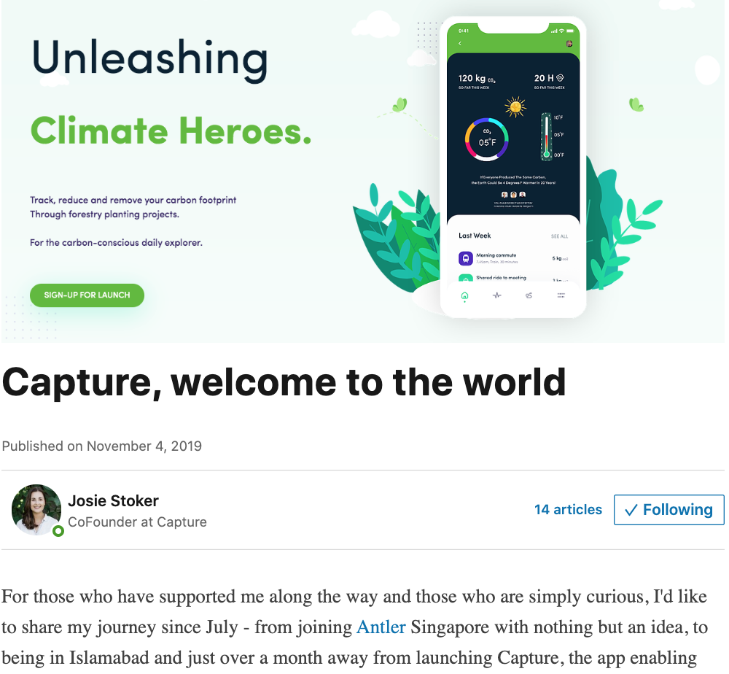
Inspiration

Slide 23
Advertising – rule of thumb
Only pay for users if you have revenue

Slide 24
Q&A

Slide 25
Great reading
Growth for startups: https://www.startupschool.org/videos/69
SaaS blog, Christoph Janz, Point Nine Capital: http://christophjanz.blogspot.com/
AppsMobile Growth Stack, growth framework for apps: https://mobilegrowthstack.com/what-is-the-mobile-growth-stack-426c6e474329
App Store Optimization: https://asostack.com/keyword-optimization-cycle-5f47388c2b5
Mixpanel (data and user analytics): https://mixpanel.com/blog/
Newsletters and automated emailsMailchimp blog and library: https://mailchimp.com/resources/
YC startup investor school: Youtube playlist - lots of perspective on what makes a great founder.
Marketing for apps academy: https://www.leanplum.com/mobile-marketing-academy/lessons/

Slide 26
Free resources
Photos
Unsplash: https://unsplash.com/
Pixabay: https://pixabay.com/en/
Icons and design assets
Tilda icons: https://tilda.cc/free-icons/
Mockups: https://www.mockupworld.co/all-mockups/

